Slide 1
How to read, summarize, and critique a research article
Caleb Kibet; Lyndon Zass

Slide 2
Outline
Session 1:
Reading a Scientific Article
Summarising a Scientific Article
Questions
Critiquing a Scientific Article
Questions
Input from participants / facilitators / trainers
Session 2:
Break out rooms / Discussions (25 minutes)
Report back (25 minutes)

Slide 3
Read
“We are drowning in information but starved for knowledge.”
John Naisbitt

Slide 4
Decide why you want to Read the paper
These could be:
to review paper for a conference or a class,
to keep current in the field
for a literature survey of a new field
The purpose for reading, should guide how you read, and to what depth.

Slide 5
What are some other reasons for reading an article?

Slide 6
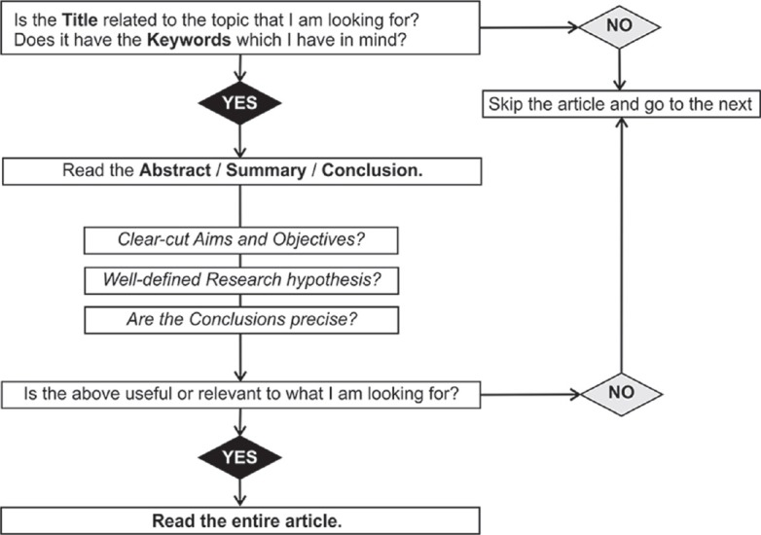
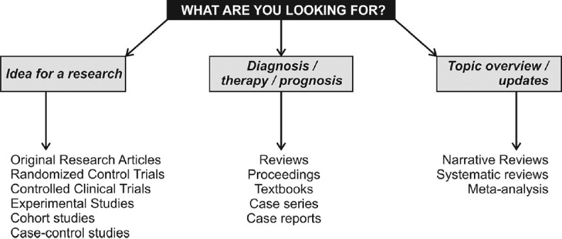
2. Choose and read the right articles
Subramanyam, R. V. (2013). Art of reading a journal article: Methodically and effectively. Journal of Oral and Maxillofacial Pathology, 17(1), 65–70. https://doi.org/10.4103/0973-029X.110733

Slide 7
3. Choose a reading approach (How)
THE THREE-PASS APPROACH: ideal for reading an entire paper in depth.
The first pass gives you a general idea about the paper.
The second pass lets you grasp the paper’s content, but not its details.
The third pass helps you understand the paper in depth.
Keshav, S. (2007). How to read a paper. In Computer Communication Review (Vol. 37, Issue 3, pp. 83–84). https://doi.org/10.1145/1273445.1273458

Slide 8
How to READ a Scientific Paper
Notes:
Use that for further insights.

Slide 9
First Pass
https://www.elsevier.com/connect/infographic-how-to-read-a-scientific-paper

Slide 10
Second Pass

Slide 11
Third Pass

Slide 12
Summarize

Slide 13
How to Summarize
Before you draft a summary:
Try to describe the article in your own words first.
Try to distill the article down to its “scientific essence.”
Include all the key points and be accurate.
A reader who has not read the original article should be able to understand your summary

Slide 14
To write a summary
Ask yourself:
What is the purpose of the study?
What questions were asked?
How did the study address these questions?
What assumptions did the author make?
What were the major findings?
What surprised you or struck you as interesting?
What questions are still unanswered?

Slide 15
In the next session, we’ll summarise the assigned article using the points above.

Slide 17
Critique
What does it mean to critique an article?
Critically read a research article and reflect upon it.
Identify the strong and weak sides of the piece.
Assess how well the author interprets its sources.
Reflect upon the validity and effectiveness of the arguments.
Prerequisites
Critical thinking is key.
Must be able to distinguish solid arguments from weak ones.
Knowledge
POV

Slide 18
Critique - Why?
Important skill for researchers
Allows you to learn from others
Improve your own research
Avoid protocol pitfalls
Collate and distinguish between similar studies
Important skill for reviewers
Critically evaluate published papers
Ensure published papers are of a specific standard.

Slide 19
Critique - Main Steps
Step 1. Read the Article
Step 2. Collect Proof
Step 3. Formatting Your Paper
Step 4. Write-up Critique

Slide 20
Critique - Main Steps
Step 1. Read the Article
Read carefully & thoroughly
Ensure that you fully understand all the information.
Consider the following questions:
Why is the article’s author considered an expert in their field?
What is the author’s thesis/hypothesis?
Who is the article’s target audience?
Are the arguments presented valid?
What are the logical fallacies in the author’s viewpoint?
Is the conclusion clear and logical?

Slide 21
Critique - Main Steps
Step 2. Collect Proof
Article Following Formal Logic / Identify Logical Fallacies
Correlation vs. Causation
Wishful Thinking
Search for Any Biased Opinions in the Article
Evaluate the Language Used in the Article
Pay Attention to the Way the Author Interprets Others’ Texts.
Check Cited Sources
Question the Research Methods
How is the design of the study? Are there any errors in it?
Was there a control group used for this research?
Were there any sample size issues?
Were there any statistical errors?
Does the research offer any real impact / value in its field?

Slide 22
Critique - Main Steps
Step 3. Formatting Your Critique Paper
Various ways to format paper
Template and example available here
Key structural considerations
Background
Introduction
Methods
Results
Discussion

Slide 23
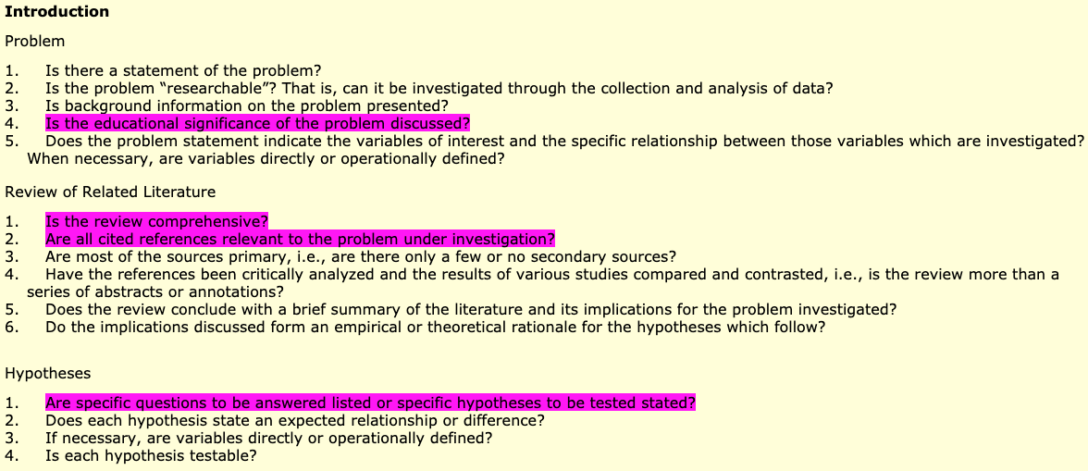
Step 4. Write-up Critique

Slide 24
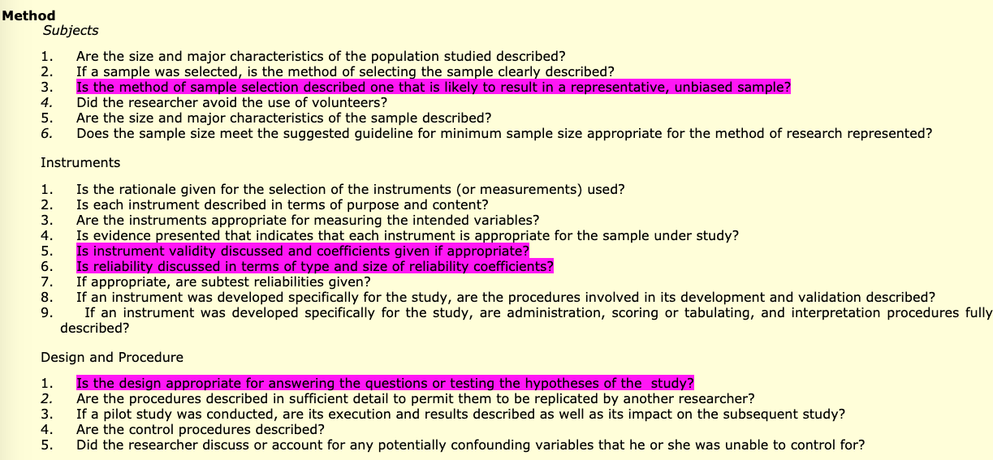
Step 4. Write-up Critique

Slide 25
Step 4. Write-up Critique

Slide 26
Key Takeaways
Reading, summarising and critiquing articles are crucial skills for every scientist.
Everyone does it a little bit differently
Consider points highlighted
Guidelines for implementation of skills
Enable personal and skill development

